Slide 1
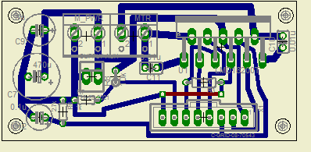
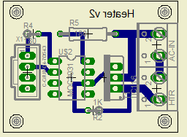
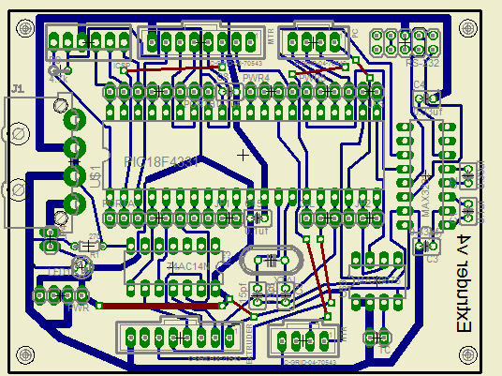
Extruder Connector Diagrams
POWER
GND
V+
M+
M-
+5 ←
Signal
N/C
N/C
A/C 1
A/C 2
HTR+
HTR-
HEATER
Vsupply
T. Flg →
CSense →
Brake ←
Dir ←
PWM ←
VSense →
Gnd
Vsupply
T. Flg →
CSense →
Brake ←
Dir ←
PWM ←
VSense →
Gnd
MOTOR BRIDGE
MOTOR BRIDGE
PC
ICSP
PGM
PGC
PGD
GND
VCC
MCLR
STEP ←
DIR ←
EN ←
FALT ←
Heater
Motor Bridge
PC SERIAL
N/C
GND
GND
+5 V
POWER
Vcc
CHA ←
CHB ←
INDX ←
LIMIT1 ←
LIMIT2 ←
N/C
Gnd
EXTRUDER
HEATER
TCOUPLE
+5
Sig
N/C
GND
K+
K-

